Slide 1
The Impact of external factors on the stock market
Submitted By: Amit Shukrun and Omer Ran Bashusha

Slide 2
Stages of research
01
Research question
02
Data handling
03
EDA
04
Models
05
Conclusions

Slide 3
Our research question
In our project we will examine whether external factors such as: people of high status and social influence affect the stock market.
In addition, we will examine whether important dates have a direct impact on the stock market.

Slide 4
Data handling
Crawlling
Functions
API
Python

Slide 5
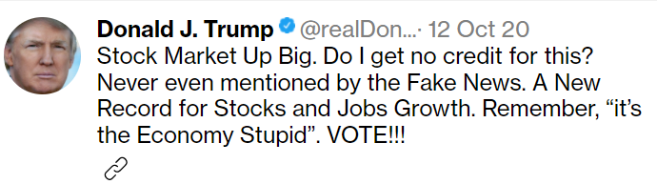
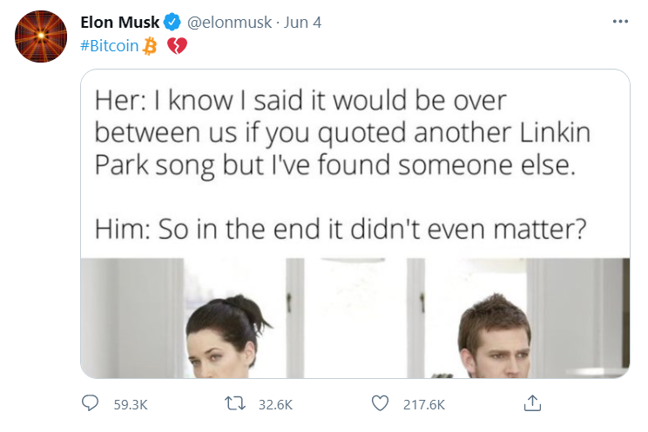

Tweets
First, we will represent influential tweets

Slide 6
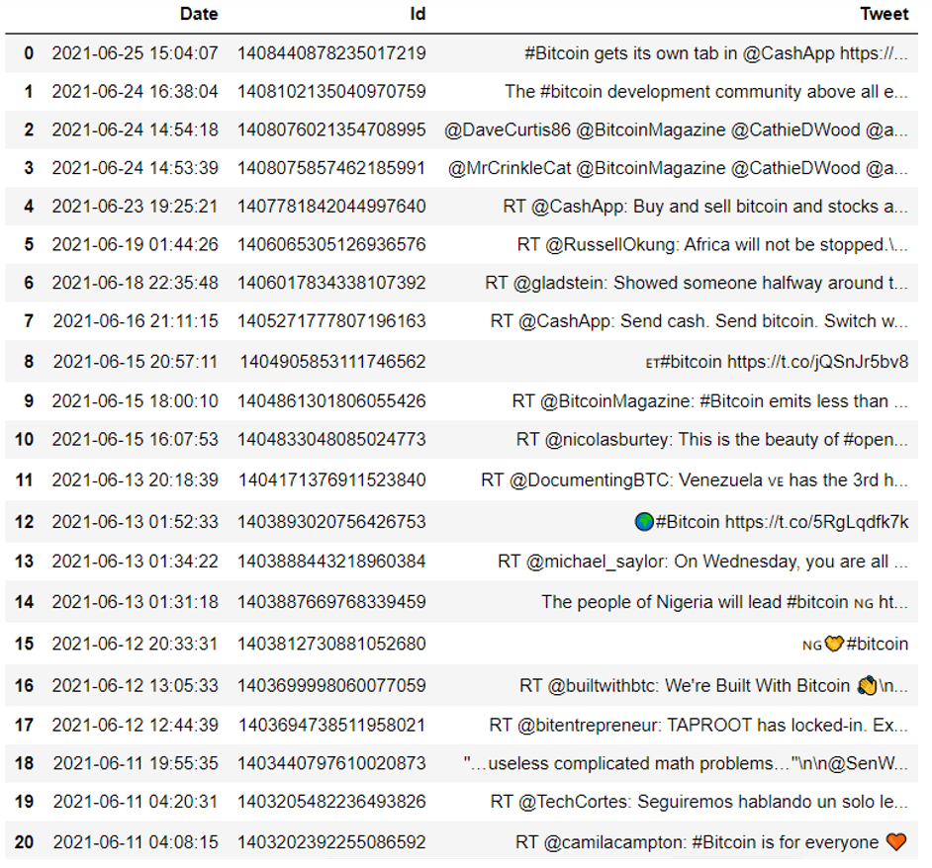
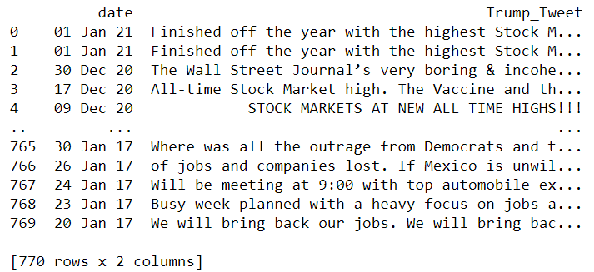
Tweets
Musk tweets
Trump tweets

Slide 7
Visualization

Slide 8
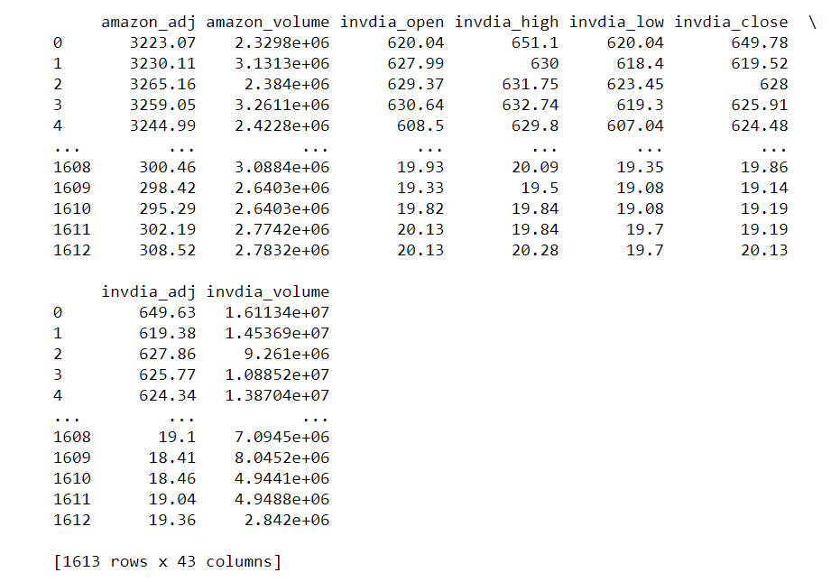
Visualization

Slide 9
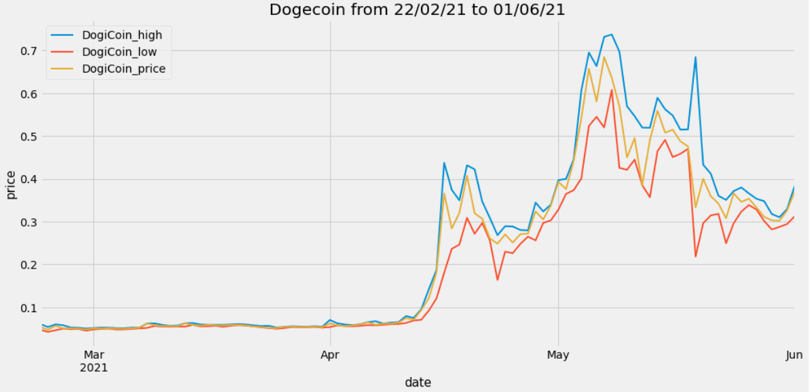
Visualization

Slide 10
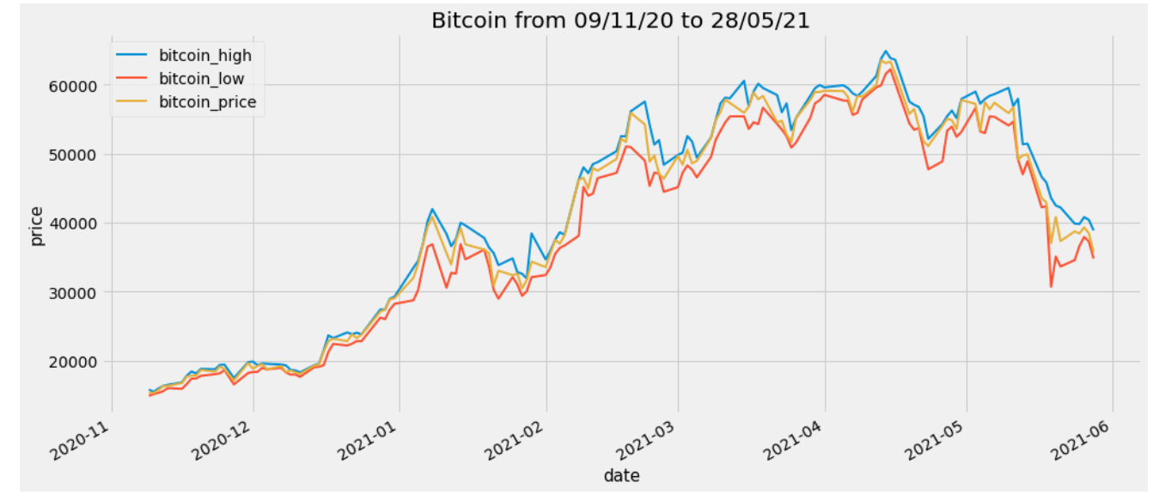
Visualization

Slide 11
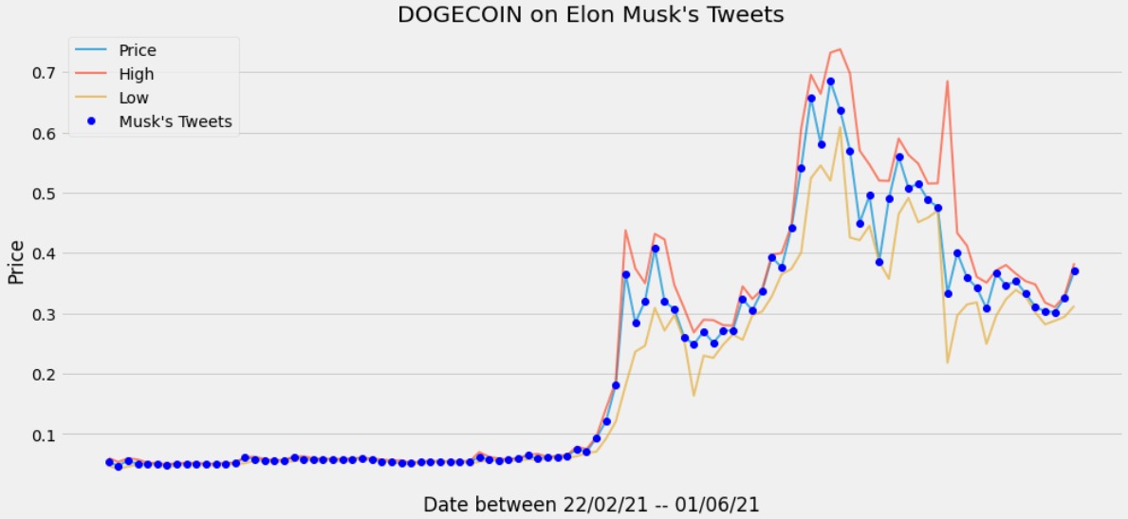
Visualization

Slide 12
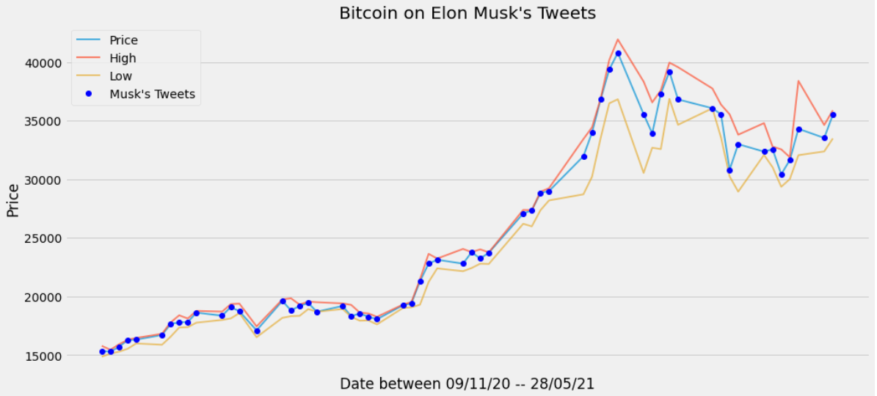
Visualization

Slide 13
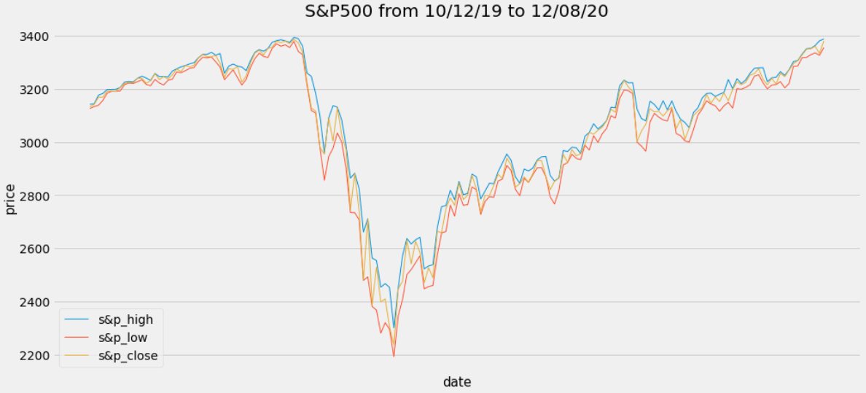
Visualization

Slide 14
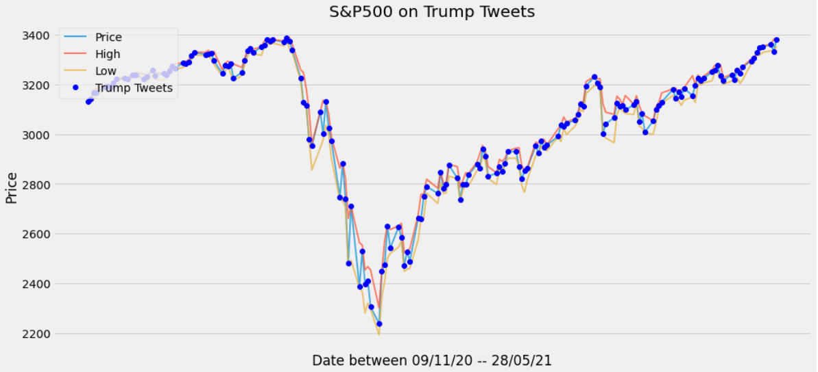
Visualization

Slide 15
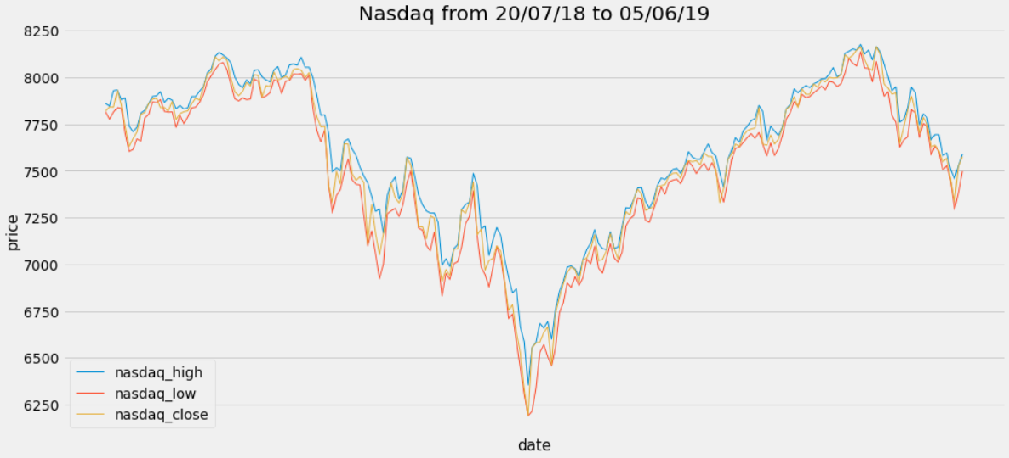
Visualization

Slide 16
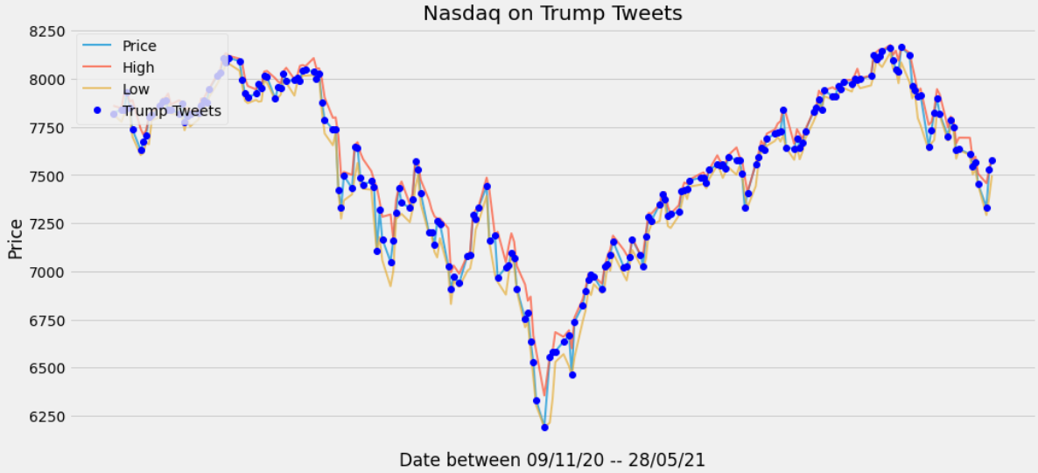
Visualization

Slide 17
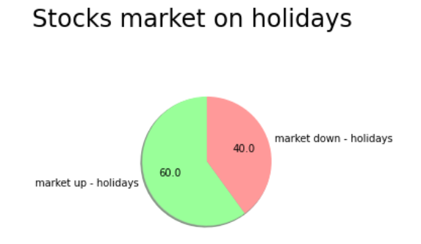
Visualization

Slide 18
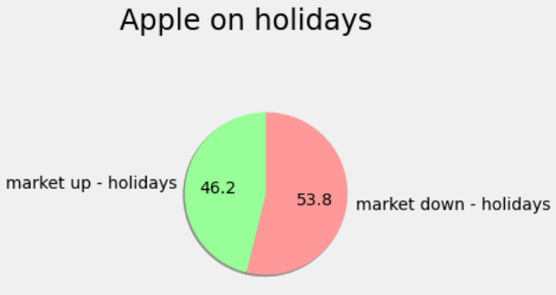
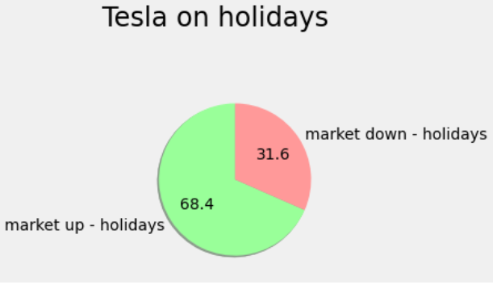
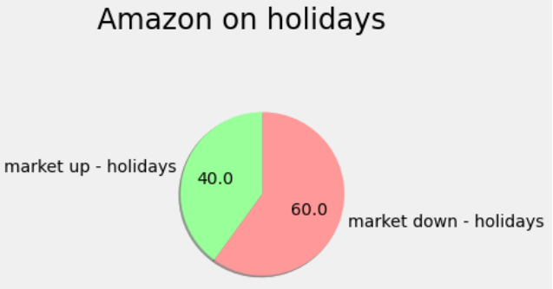
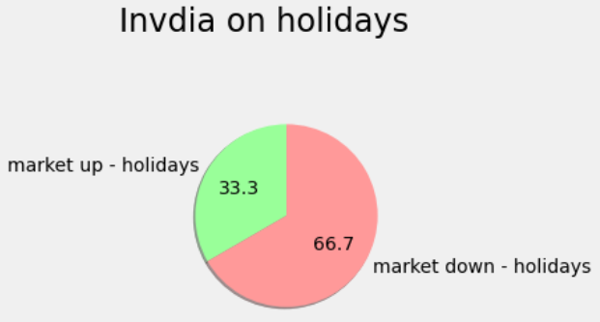
Visualization

Slide 19
Machine Learning
Get A Modern Models
SELL
BUY
SELL
BUY

Slide 20
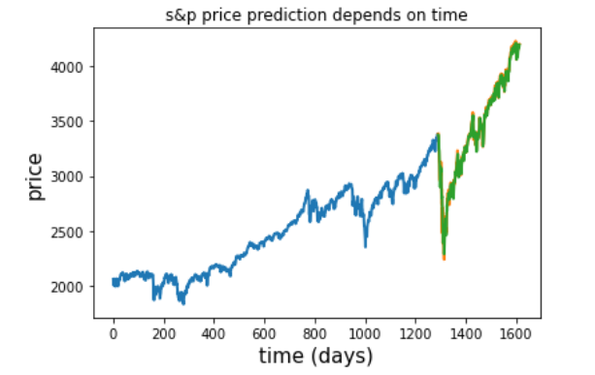
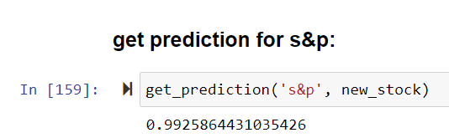
Machine Learning
Get A Modern Model

Slide 21
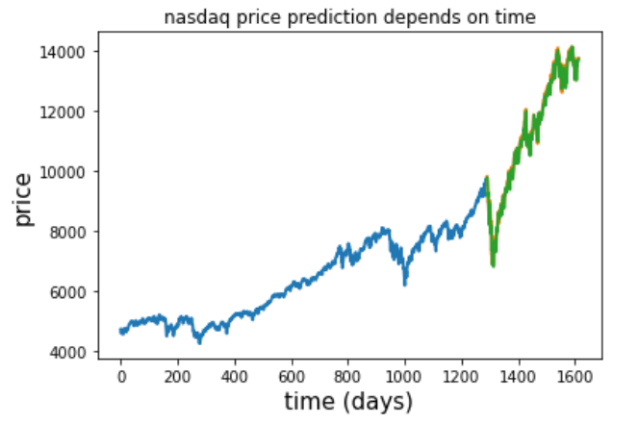
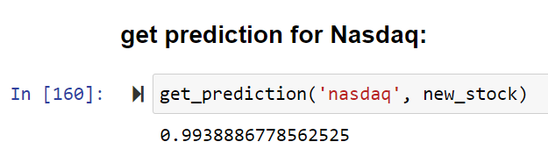
Machine Learning
Get A Modern Models

Slide 22
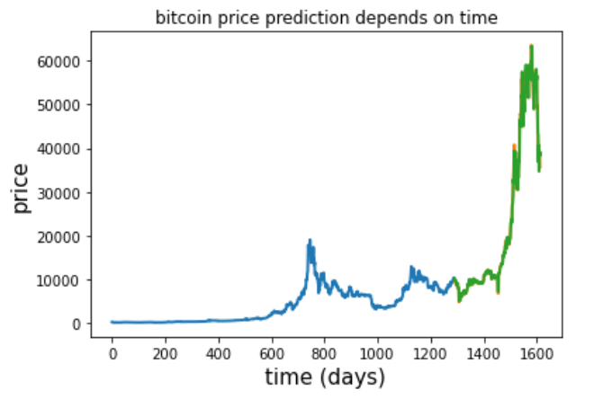
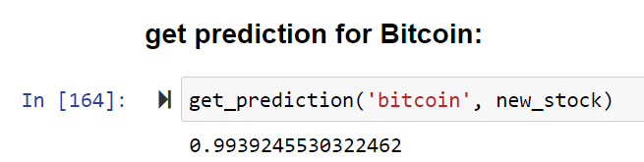
Machine Learning
Get A Modern Models

Slide 23
In conclusion
We have seen that there are external factors that create a clear impact on the stock and crypto market. We have clearly seen from the graphs that the tweets cause the market to change direction and in addition create extremes points on the graph. In addition, we have seen that on holidays the market ends trading days in 60% of cases in a positive trend. This figure indicates the impact of the holidays on the stock market.

Slide 24
Sources
Dataframe Source (stock market): https://finance.yahoo.com ("s&p, "Nasdaq, "bitcoin”, “dogecoin”)
Trump tweets: https://www.bloomberg.com/features/trump-tweets-market
Elon mask tweets: twitter – elon mask eccount
Link to GitHub : https://github.com/omerrb/stock_market_ai

Slide 25

Thank You
Amit Shukrun and Omer Ran Bashusha

